Slide 1
Introduction to FPGAs
Dr. Philip Brisk
Department of Computer Science and Engineering
University of California, Riverside
CS 223

Slide 2
The Basics
Transistor
SRAM
1
0
Open
Closed

Slide 3
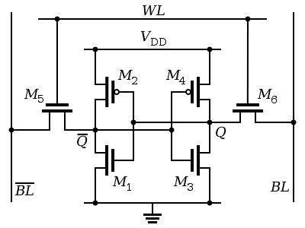
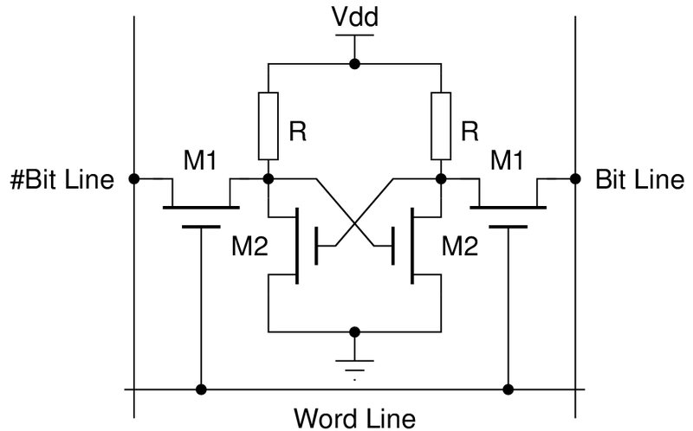
Configuration Comes at a Cost
1T
6T SRAM
4-6 T
SRAM
4T SRAM
+ Configuration circuitry
+ Error detection/correction
+ Security features
https://en.wikipedia.org/wiki/Static_random-access_memory

Slide 4
Lookup Tables (LUTs)
x
y
Commercial FPGAs
Xilinx: 6-LUT
Altera: 6-LUT
Microsemi: 4-LUT
SRAM
SRAM
SRAM
SRAM

Slide 5
LUT = Programmable Truth Table
x
y
x
y
z
0
0
A
A
0
1
B
B
z
1
0
C
C
1
1
D
D

Slide 6
AND
x
y
x
y
z
0
0
0
0
0
1
0
0
z
1
0
0
0
1
1
1
1

Slide 7
OR
x
y
x
y
z
0
0
0
0
0
1
1
1
z
1
0
1
1
1
1
1
1

Slide 8
NAND
x
y
x
y
z
0
0
1
1
0
1
1
1
z
1
0
1
1
1
1
0
0

Slide 9
NOR
x
y
x
y
z
0
0
1
1
0
1
0
0
z
1
0
0
0
1
1
0
0

Slide 10
XOR
x
y
x
y
z
0
0
0
0
0
1
1
1
z
1
0
1
1
1
1
0
0

Slide 11
XNOR
x
y
x
y
z
0
0
1
1
0
1
0
0
z
1
0
0
0
1
1
1
1

Slide 12
z = y
x
y
x
y
z
0
0
1
1
0
1
0
0
z
1
0
1
1
1
1
0
0

Slide 13
z = y + x
x
y
x
y
z
0
0
1
1
0
1
0
0
z
1
0
1
1
1
1
1
1

Slide 14
Basic Logic Element (BLE)

Slide 15
Configurable Logic Block (CLB)

Slide 16
FPGA

Slide 17
FPGA CAD Flow
Input:
A circuit (netlist)
Output:
FPGA configuration bitstream
Main (Algorithmic) Stages:
Logic optimization
Technology mapping
Packing/placement
Routing
Retiming

Slide 18
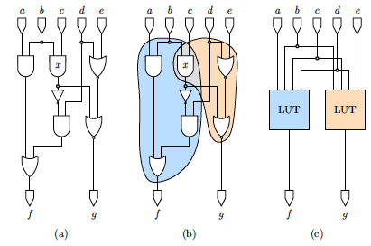
Technology Mapping
Ling et al., DAC 2005, Fig. 2

Slide 19
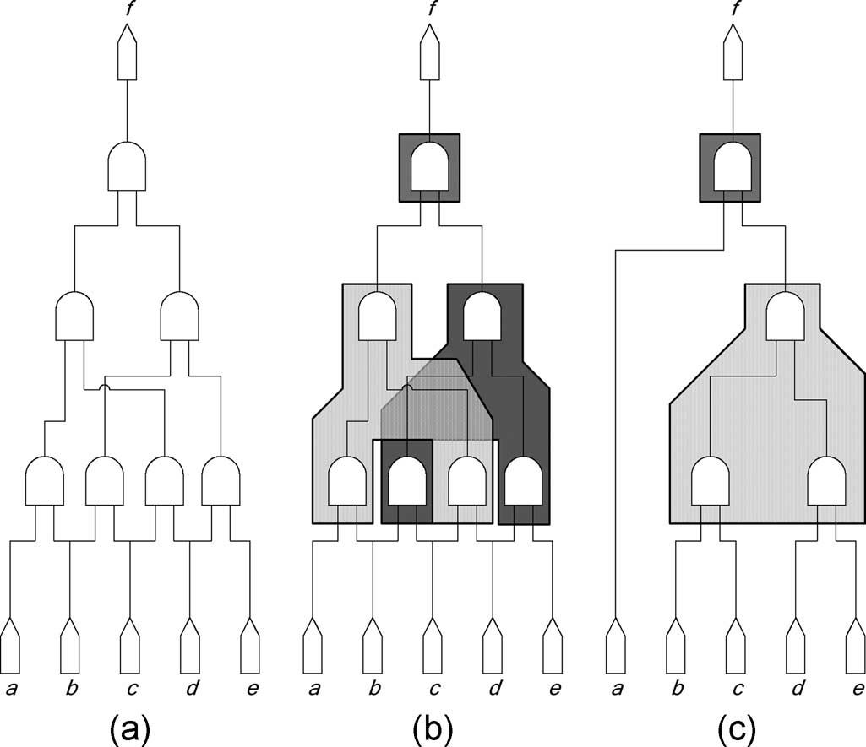
Technology Mapping + Logic Optimization
Cong and Minkovich, IEEE TCAD 26(2), Feb. 2007, Fig. 1

Slide 20
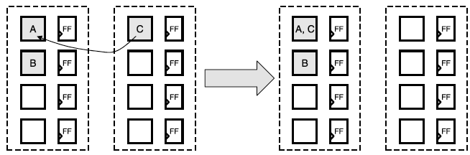
FPGA Packing
Assume that each CLB contains two BLEs
Ahmed et al., ACM TRETS 2(3), article #18, Sep. 2009, Fig. 12

Slide 21
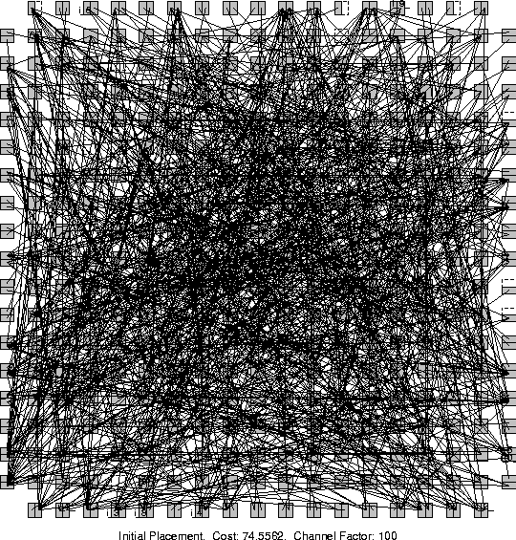
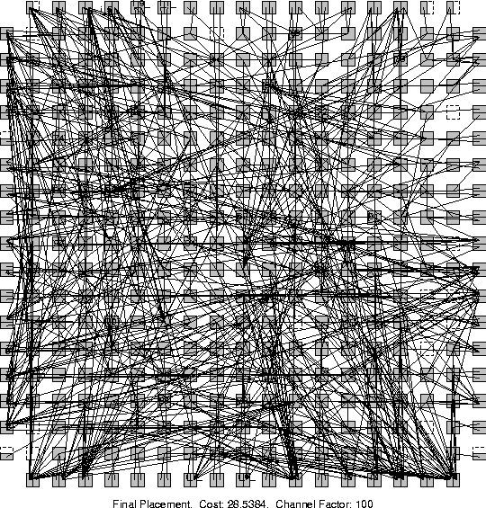
FPGA Placement
http://www.eecg.toronto.edu/~vaughn/vpr/e64.html

Slide 22
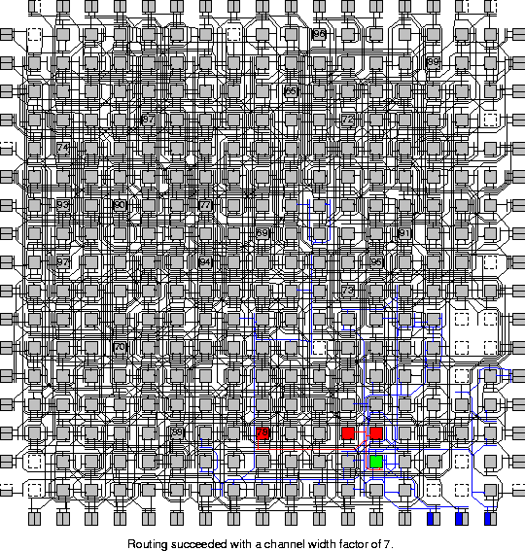
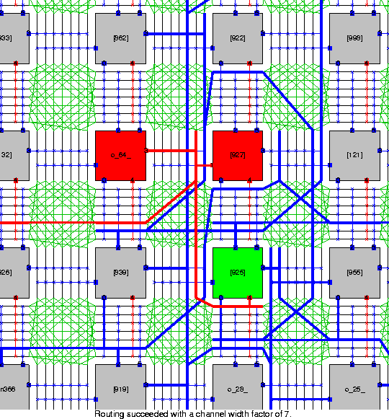
FPGA Routing
http://www.eecg.toronto.edu/~vaughn/vpr/e64.html

Slide 23
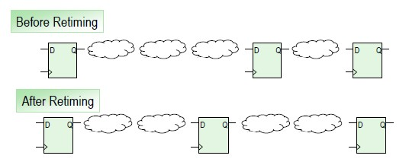
Retiming
Each cloud represents a BLE along the circuit’s critical path
Remember, routing delays between clouds are significant, and you don’t know them until AFTER placement and routing are done.
http://www.xilinx.com/support/answers/40089.html

Slide 24
Introduction to FPGA Design
J. Serrano, CERN, Geneva, Switzerland
http://cds.cern.ch/record/1100537/files/p231.pdf

Slide 25
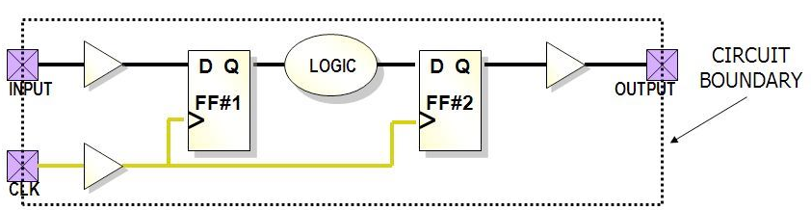
Typical Digital Design

Slide 26
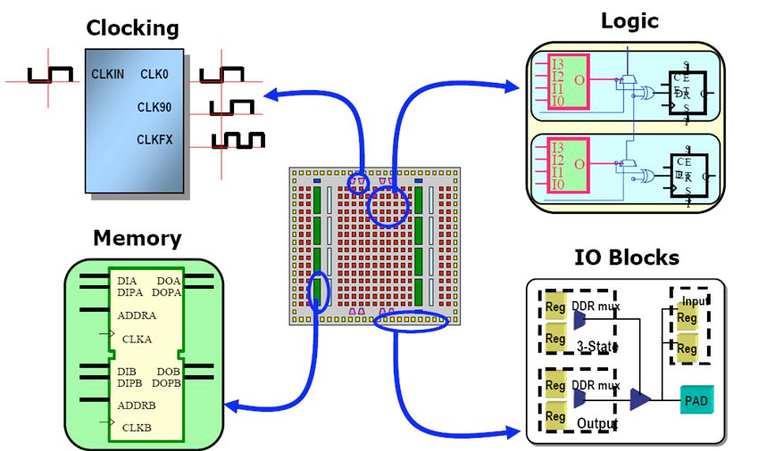
FPGA Structure

Slide 27
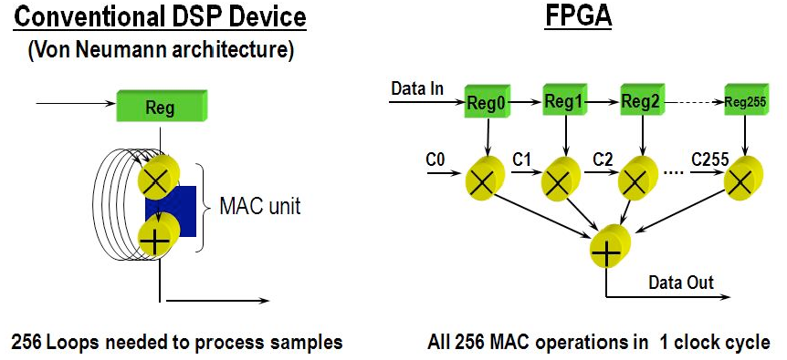
Signal Processing: CPU vs. FPGA

Slide 28
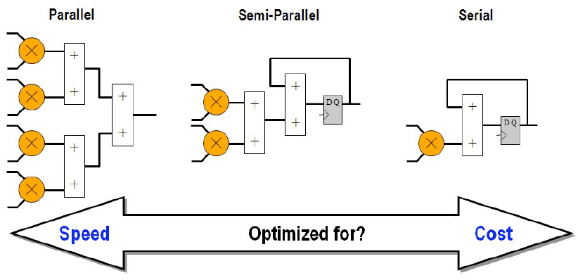
Speed/Area Tradeoff

Slide 29
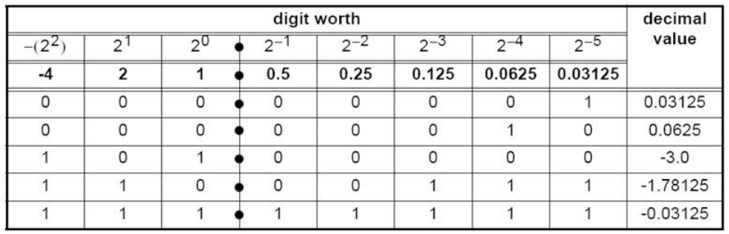
Fixed-Point Arithmetic
In this example
Two’s complement (signed)
3 integer bits
5 fractional bits

Slide 30
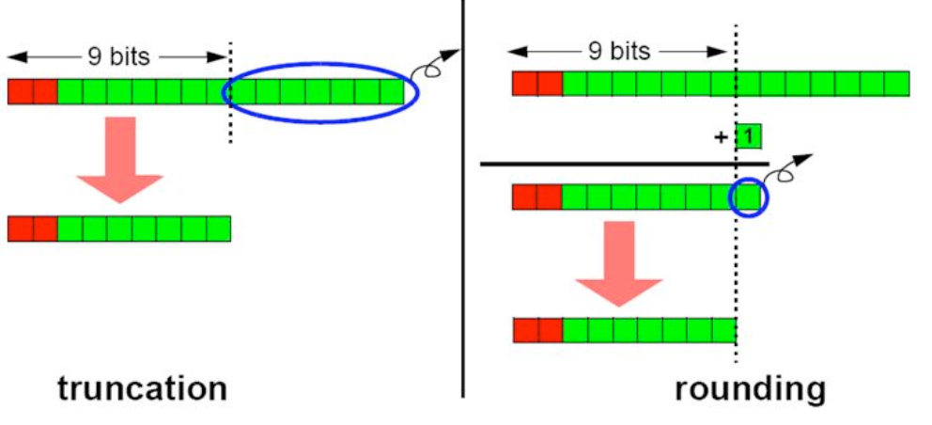
Truncation vs. Rounding in Fixed-Point

Slide 31
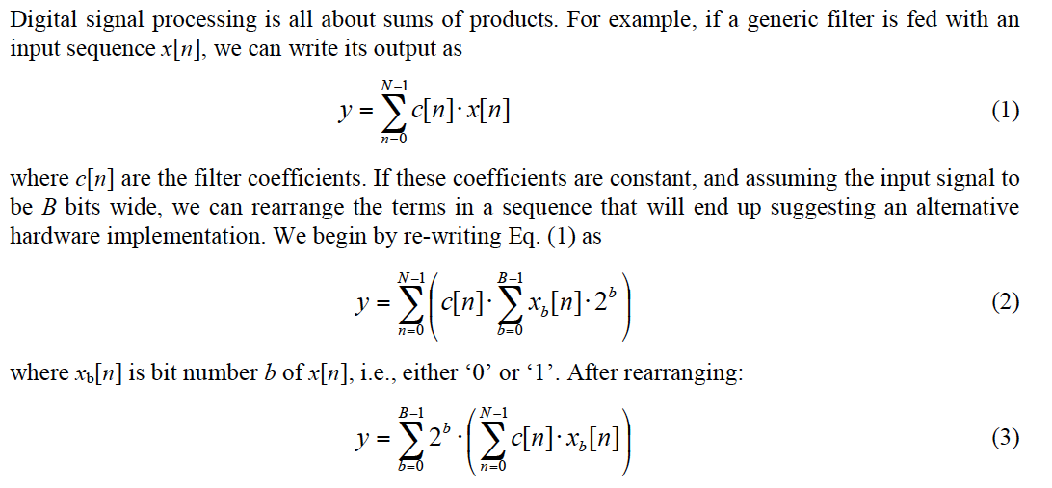
Distributed Arithmetic
Shift c[n] left by b
X_{b}[n] is 0 or 1

Slide 32
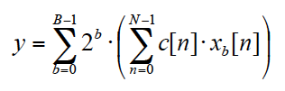
Distributed Arithmetic
c[n] or 0
X₀[n]
(c[n] << 1) or 0
X₁[n]
(c[n] << 2) or 0
X₂[n]
(c[n] << 3) or 0
X₃[n]

Slide 33
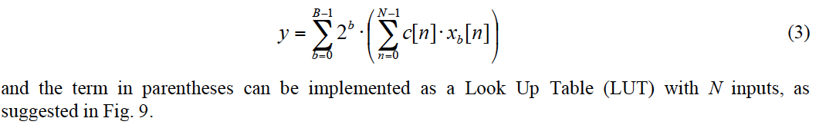
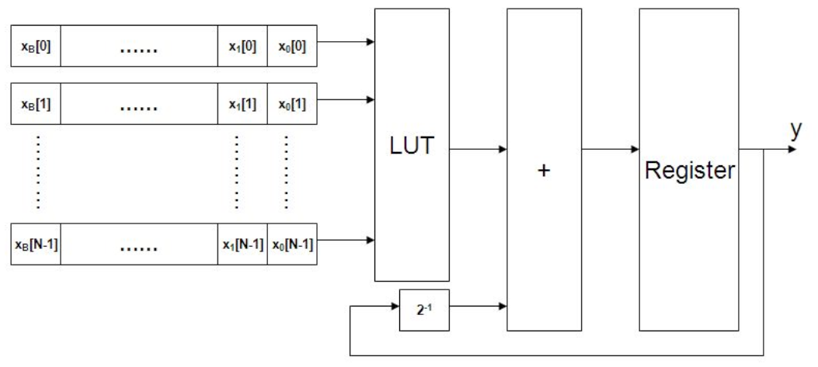
Distributed Arithmetic Architecture

Slide 34
Course Topics
FPGA architectures
Academic (VPR)
Commercial (Xilinx / Altera / Microsemi)
FPGA CAD algorithms
Compilers (e.g., C, OpenCL, etc. to FPGA)
FPGA Applications
Reconfigurable alternatives to FPGAs
The history of reconfigurable computing
Going back to the vacuum tube era

